Slide 1
MARKET SEGMENTATION
Alma & Paulo

Slide 2
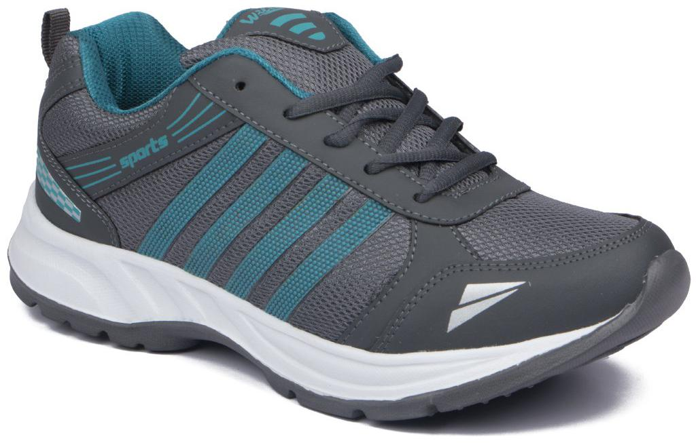
NEW ASIAN SPORT SHOES – WE HAVE SPORT SHOES TO SELL

Slide 3
NEW ASIAN SPORT SHOES
PROBLEM 1 - how can i distinguish my people from the rest of the market
Criterias: Age, Sex, marital Status, occupation, Income, Education, religion , nationality, online habits, loyalty, location, interests, beliefs, values, attitudes,
PROBLEM 2 – adjust communication strategy to each segment
Promotion, place (distribution channel), product and price

Slide 4
NEW ASIAN SPORT SHOES
Data analysis
Divide customers in Groups
Explore the differences among the groups
Select your Group
Know insights about group

Slide 5
NEW ASIAN SPORT SHOES
Avoid spending Money advertising for wrong people
1
Avoid creating wrong products
2
Create segment oriented/tailored products & communication
3

Slide 6
NEW ASIAN SPORT SHOES
THANK YOU

